Slide 1

Wine Enthusiast
Dataset - Nolli Manuele

Slide 2

Dataset
1 Dataset
2017 - 2020
11/15 colonne interessanti
Title, Description, Points (80-100), Price (USD)
Variety, Winery, Vintage
Country , Province, Regions
TasterName
~ 80 mila righe
Una recensione per ogni riga

Slide 3
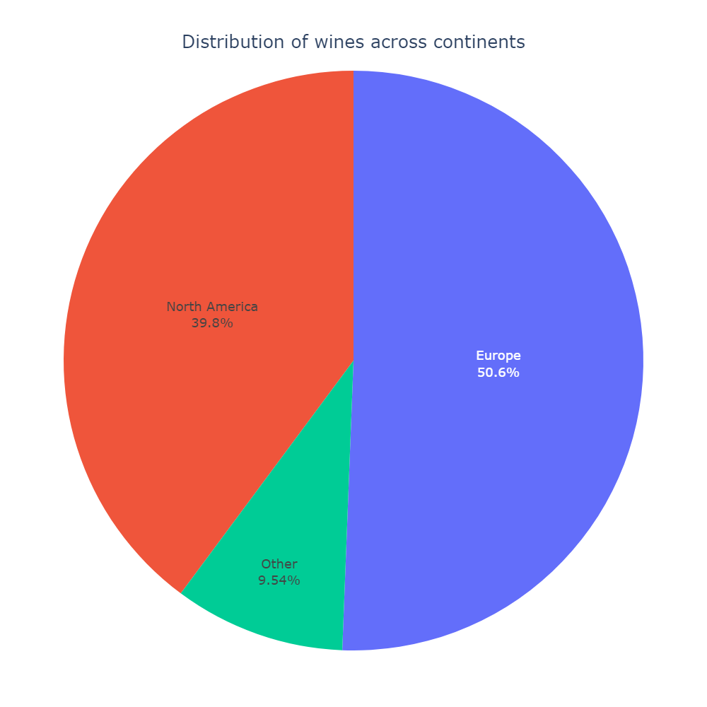
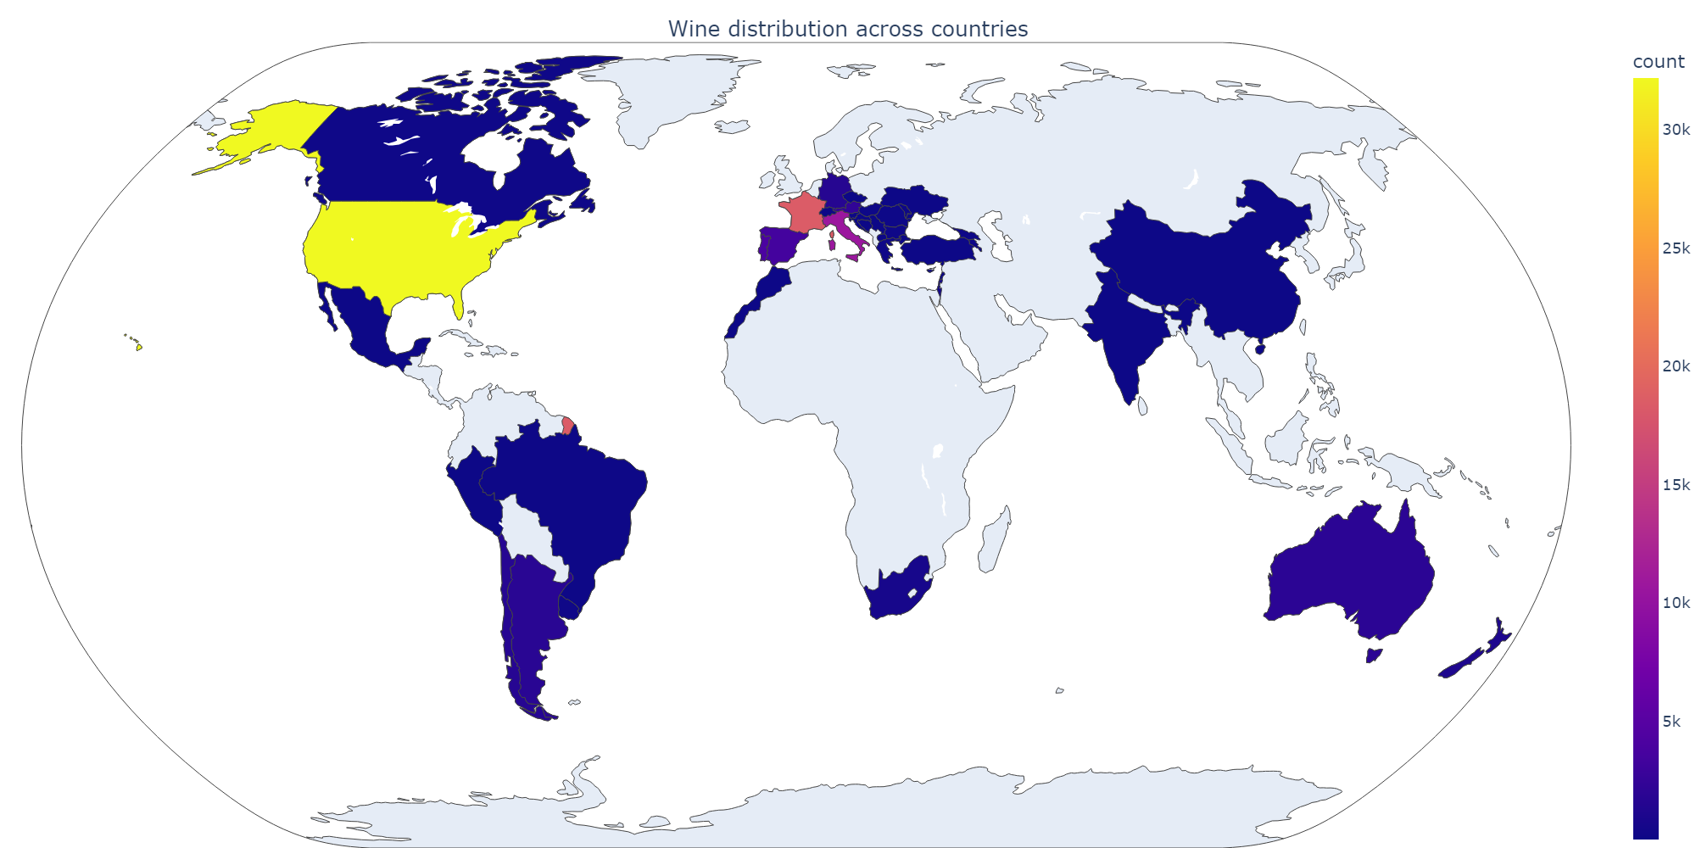
Wines distribution across continents

Slide 4
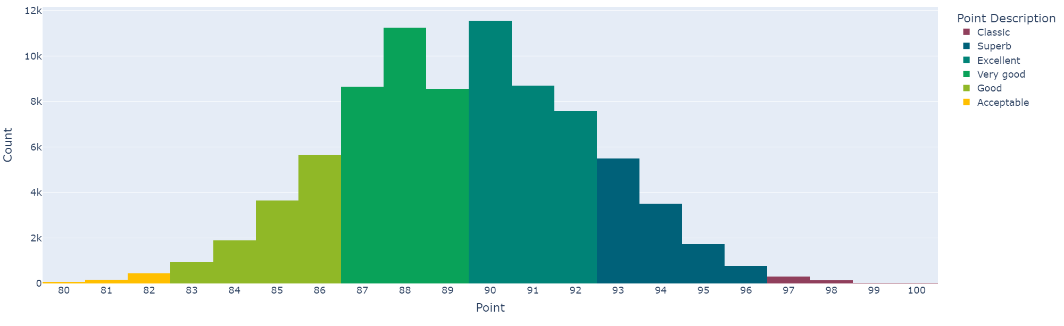
Point distribution

Slide 5
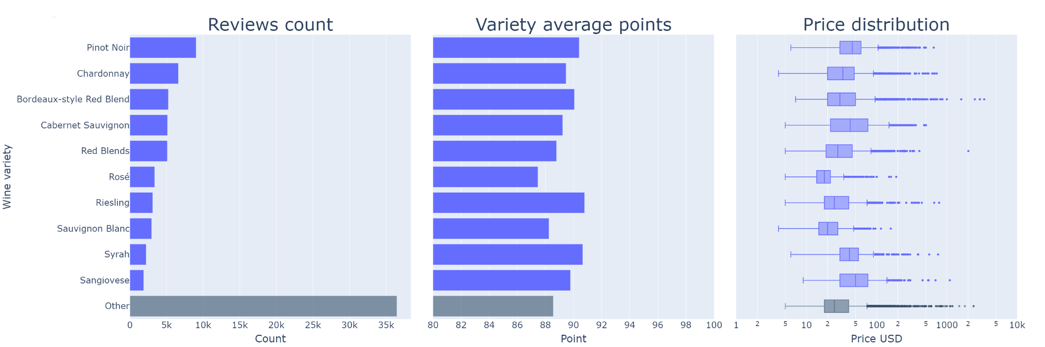
[Top 10] Reviewed wines

Slide 6
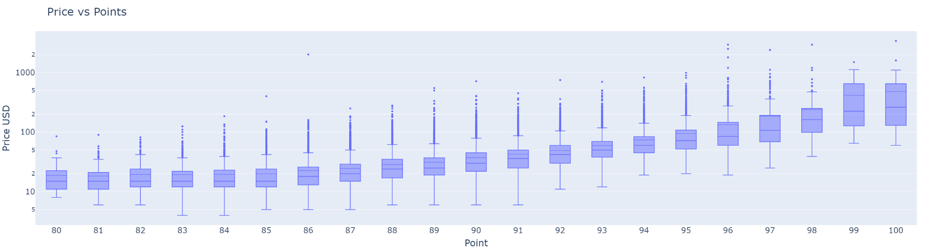
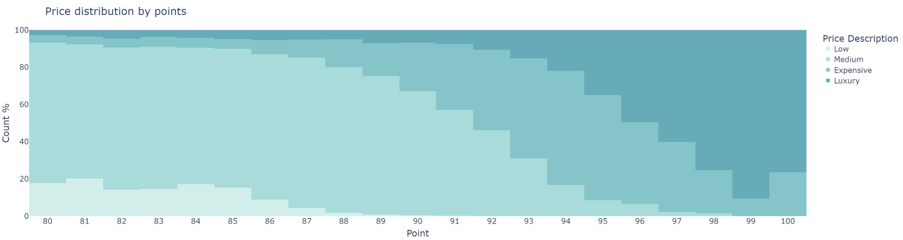
Price vs Points

Slide 7
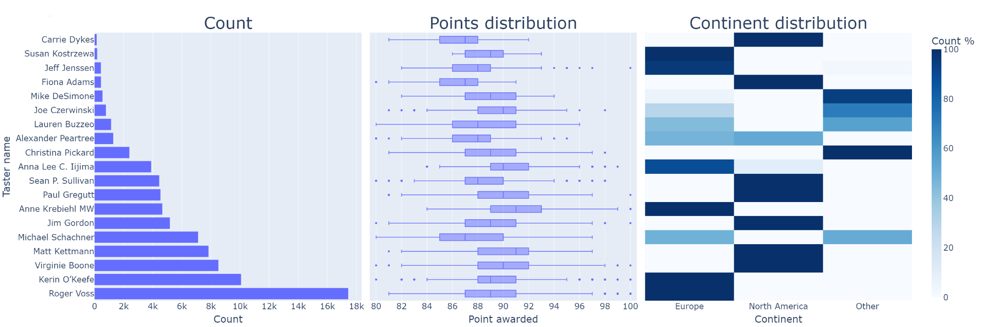
Taster reviews

Slide 8
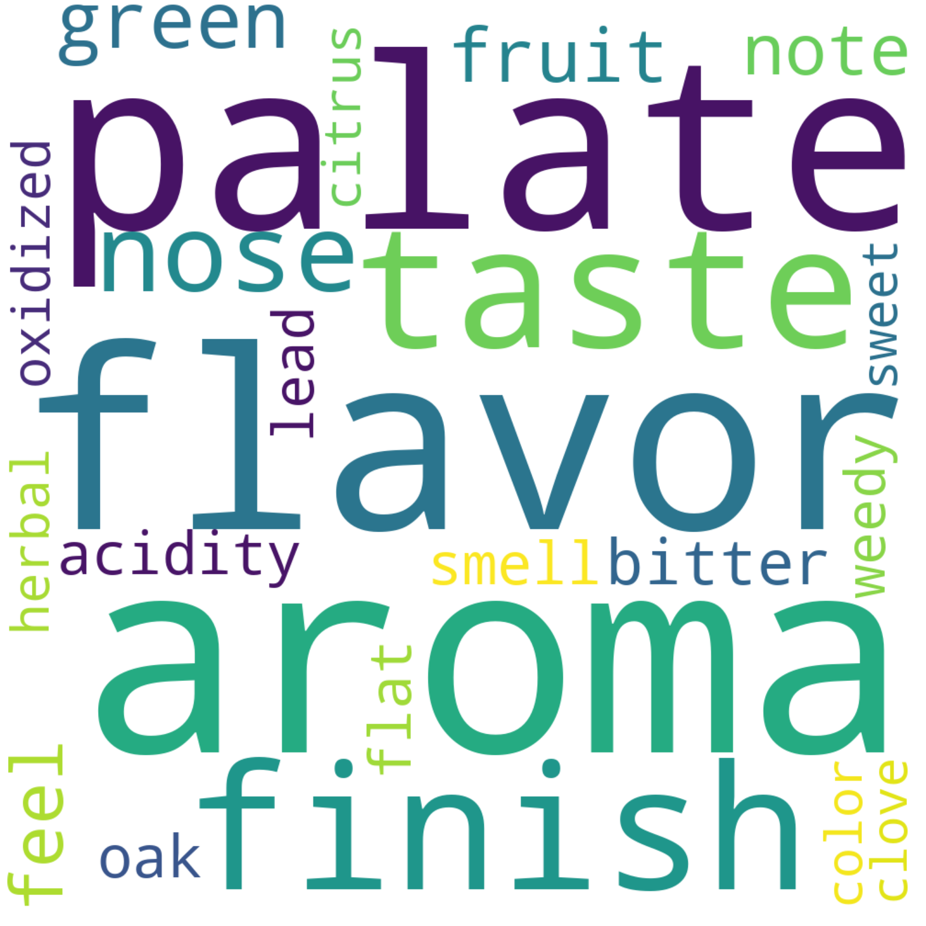
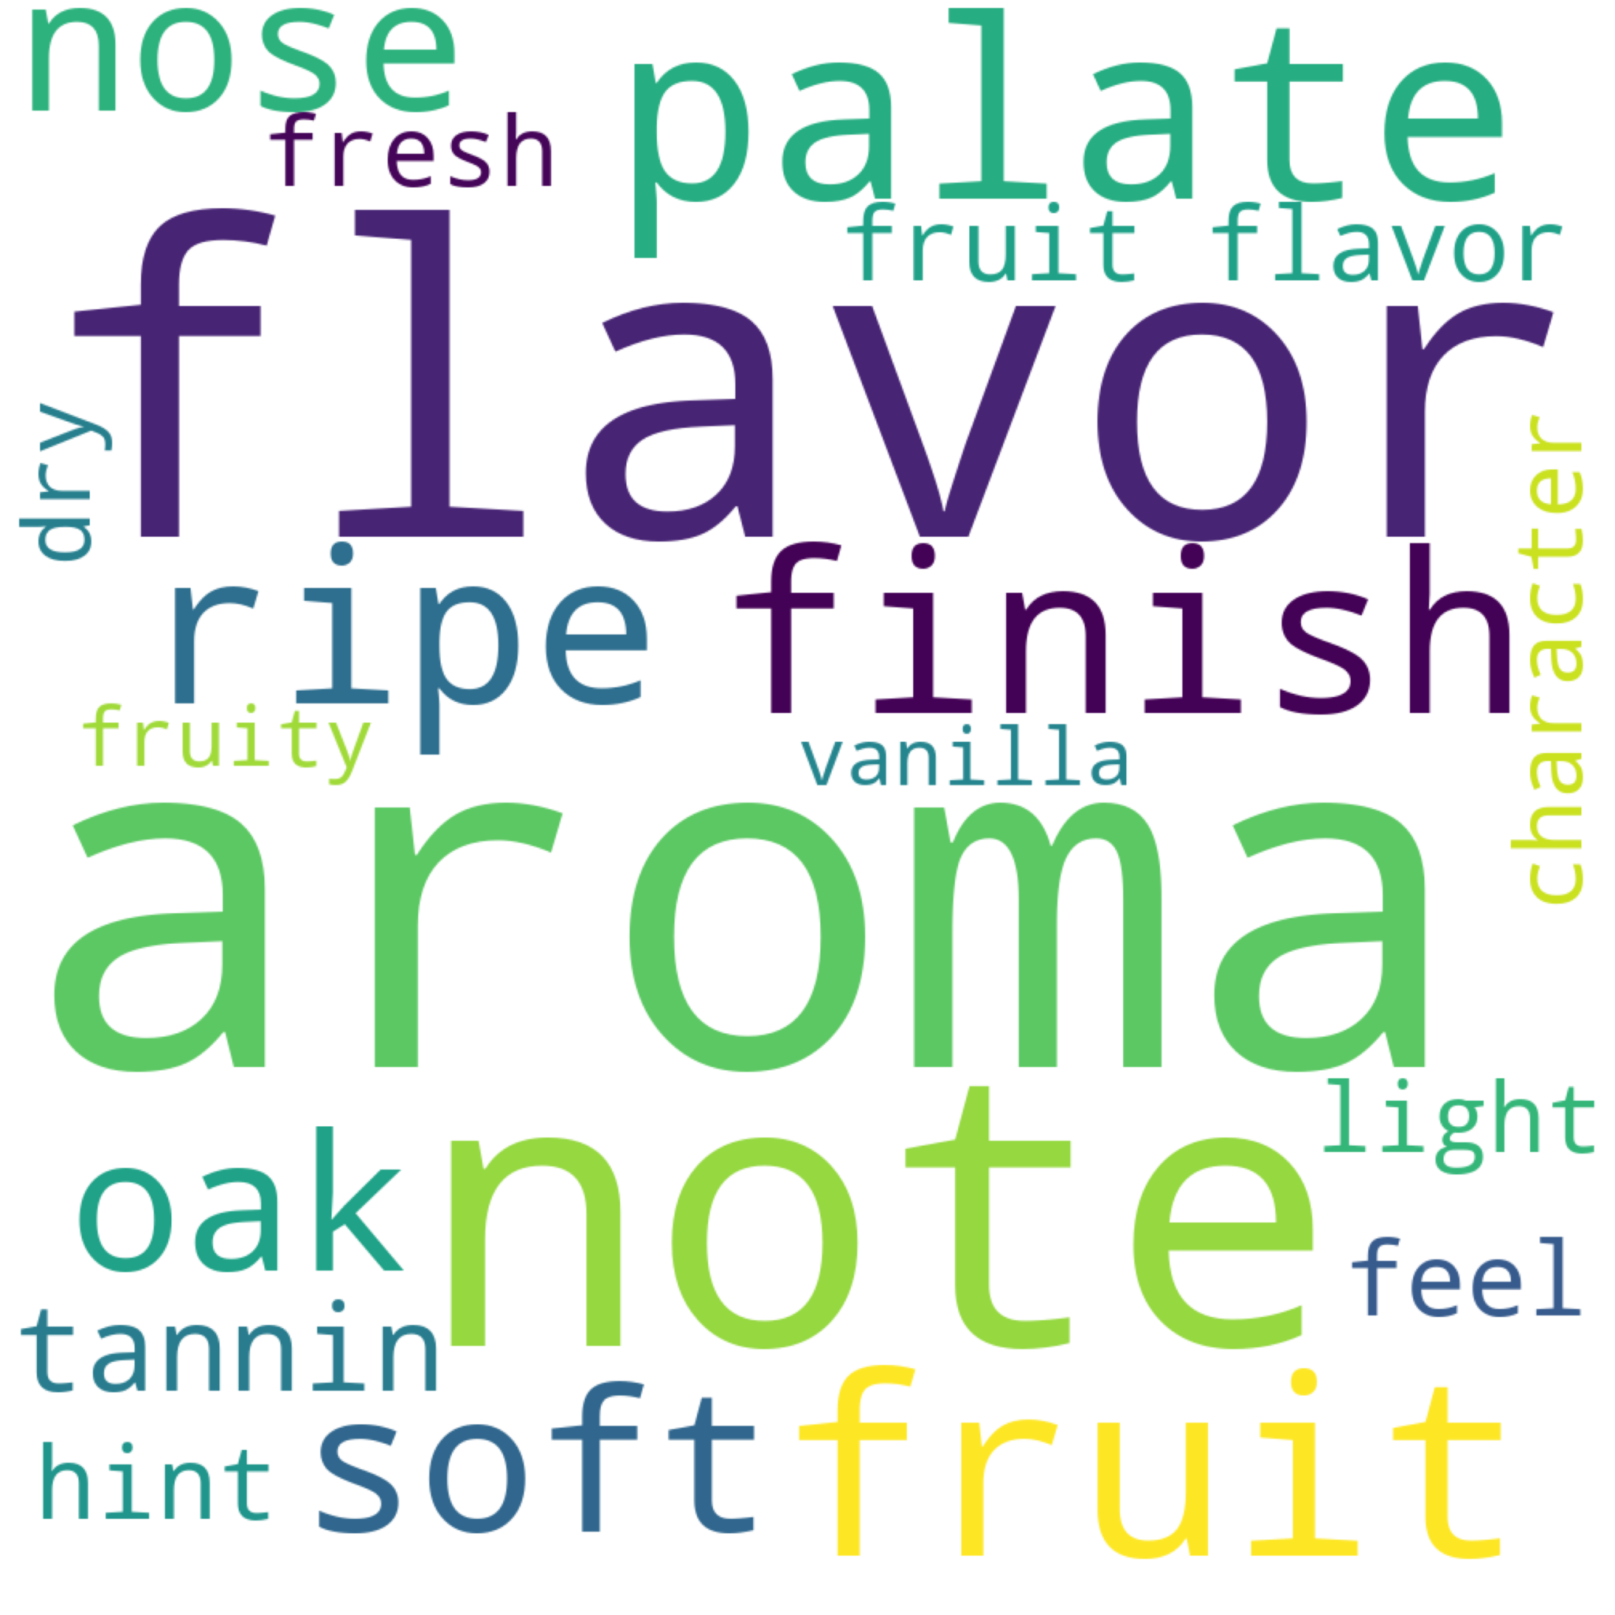
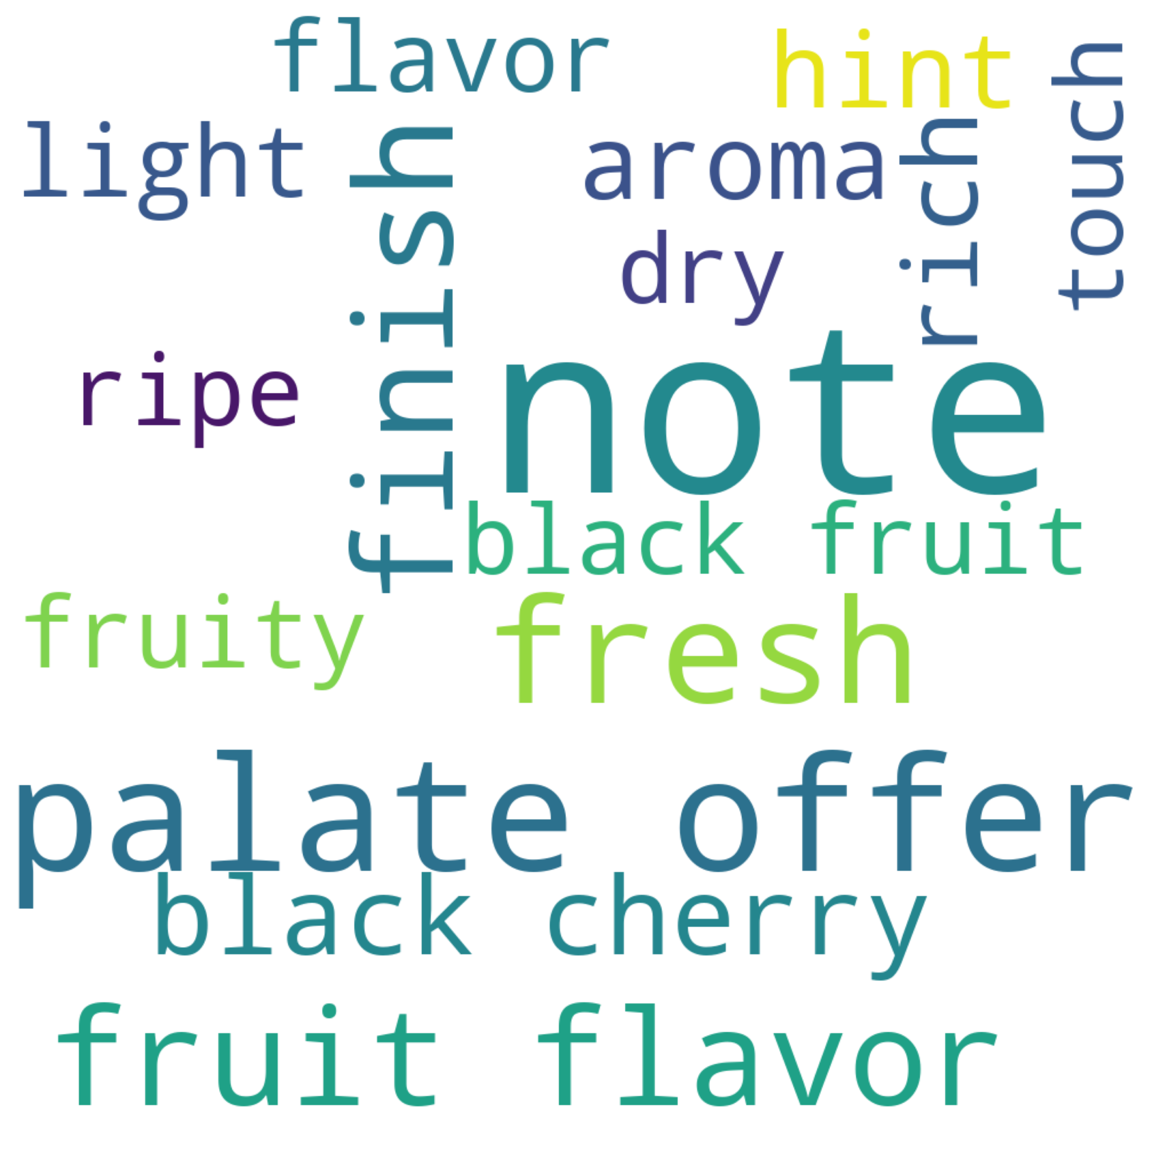
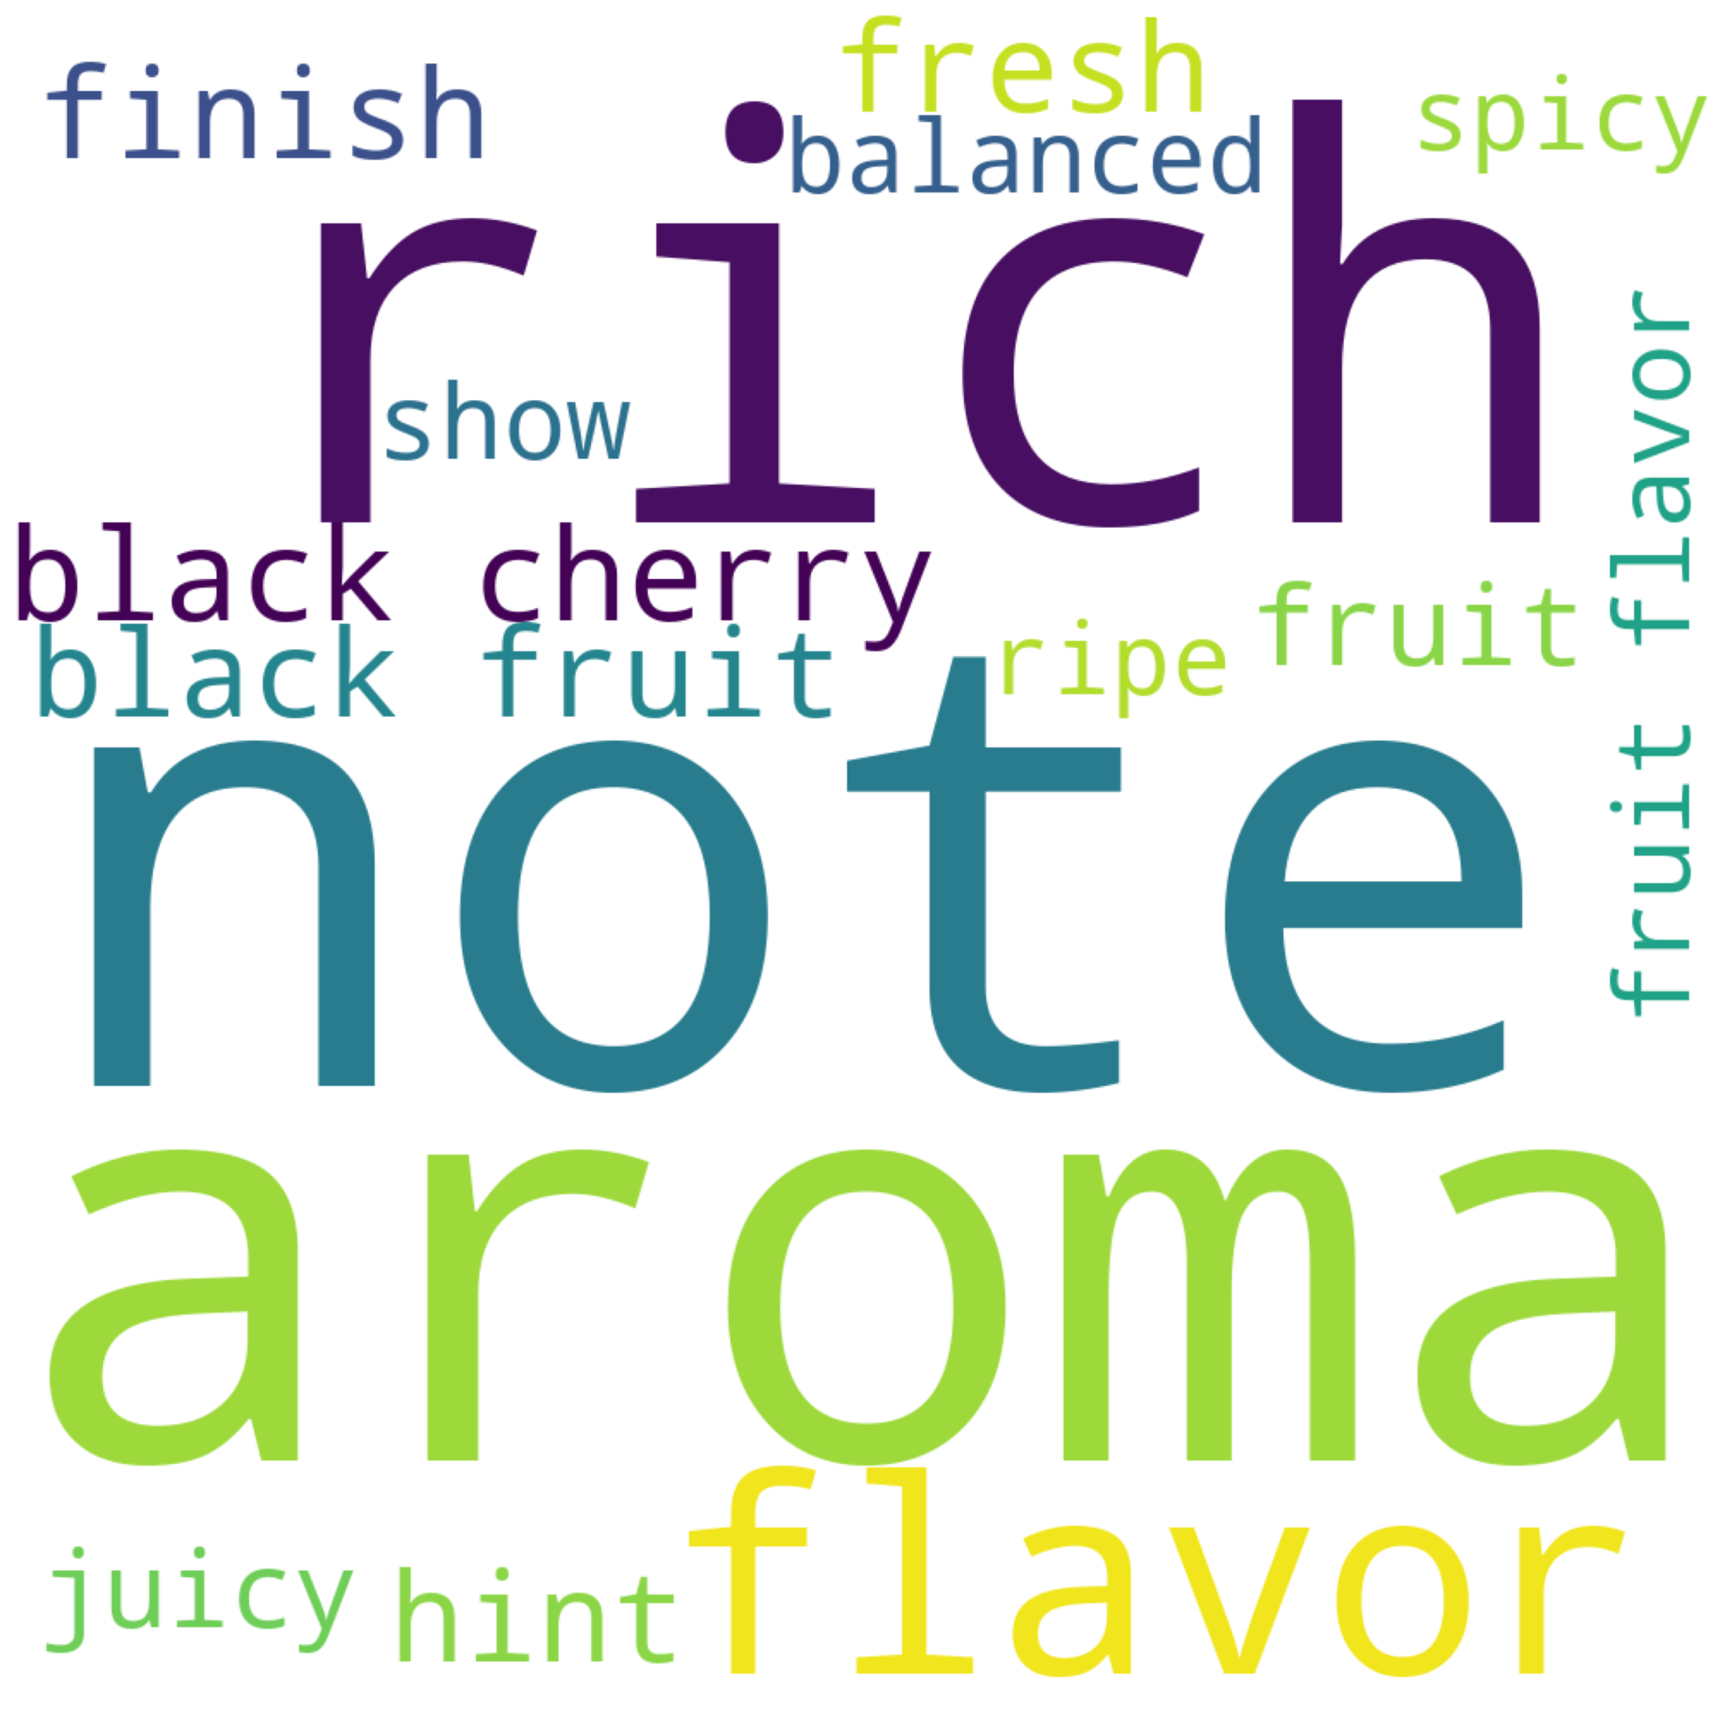
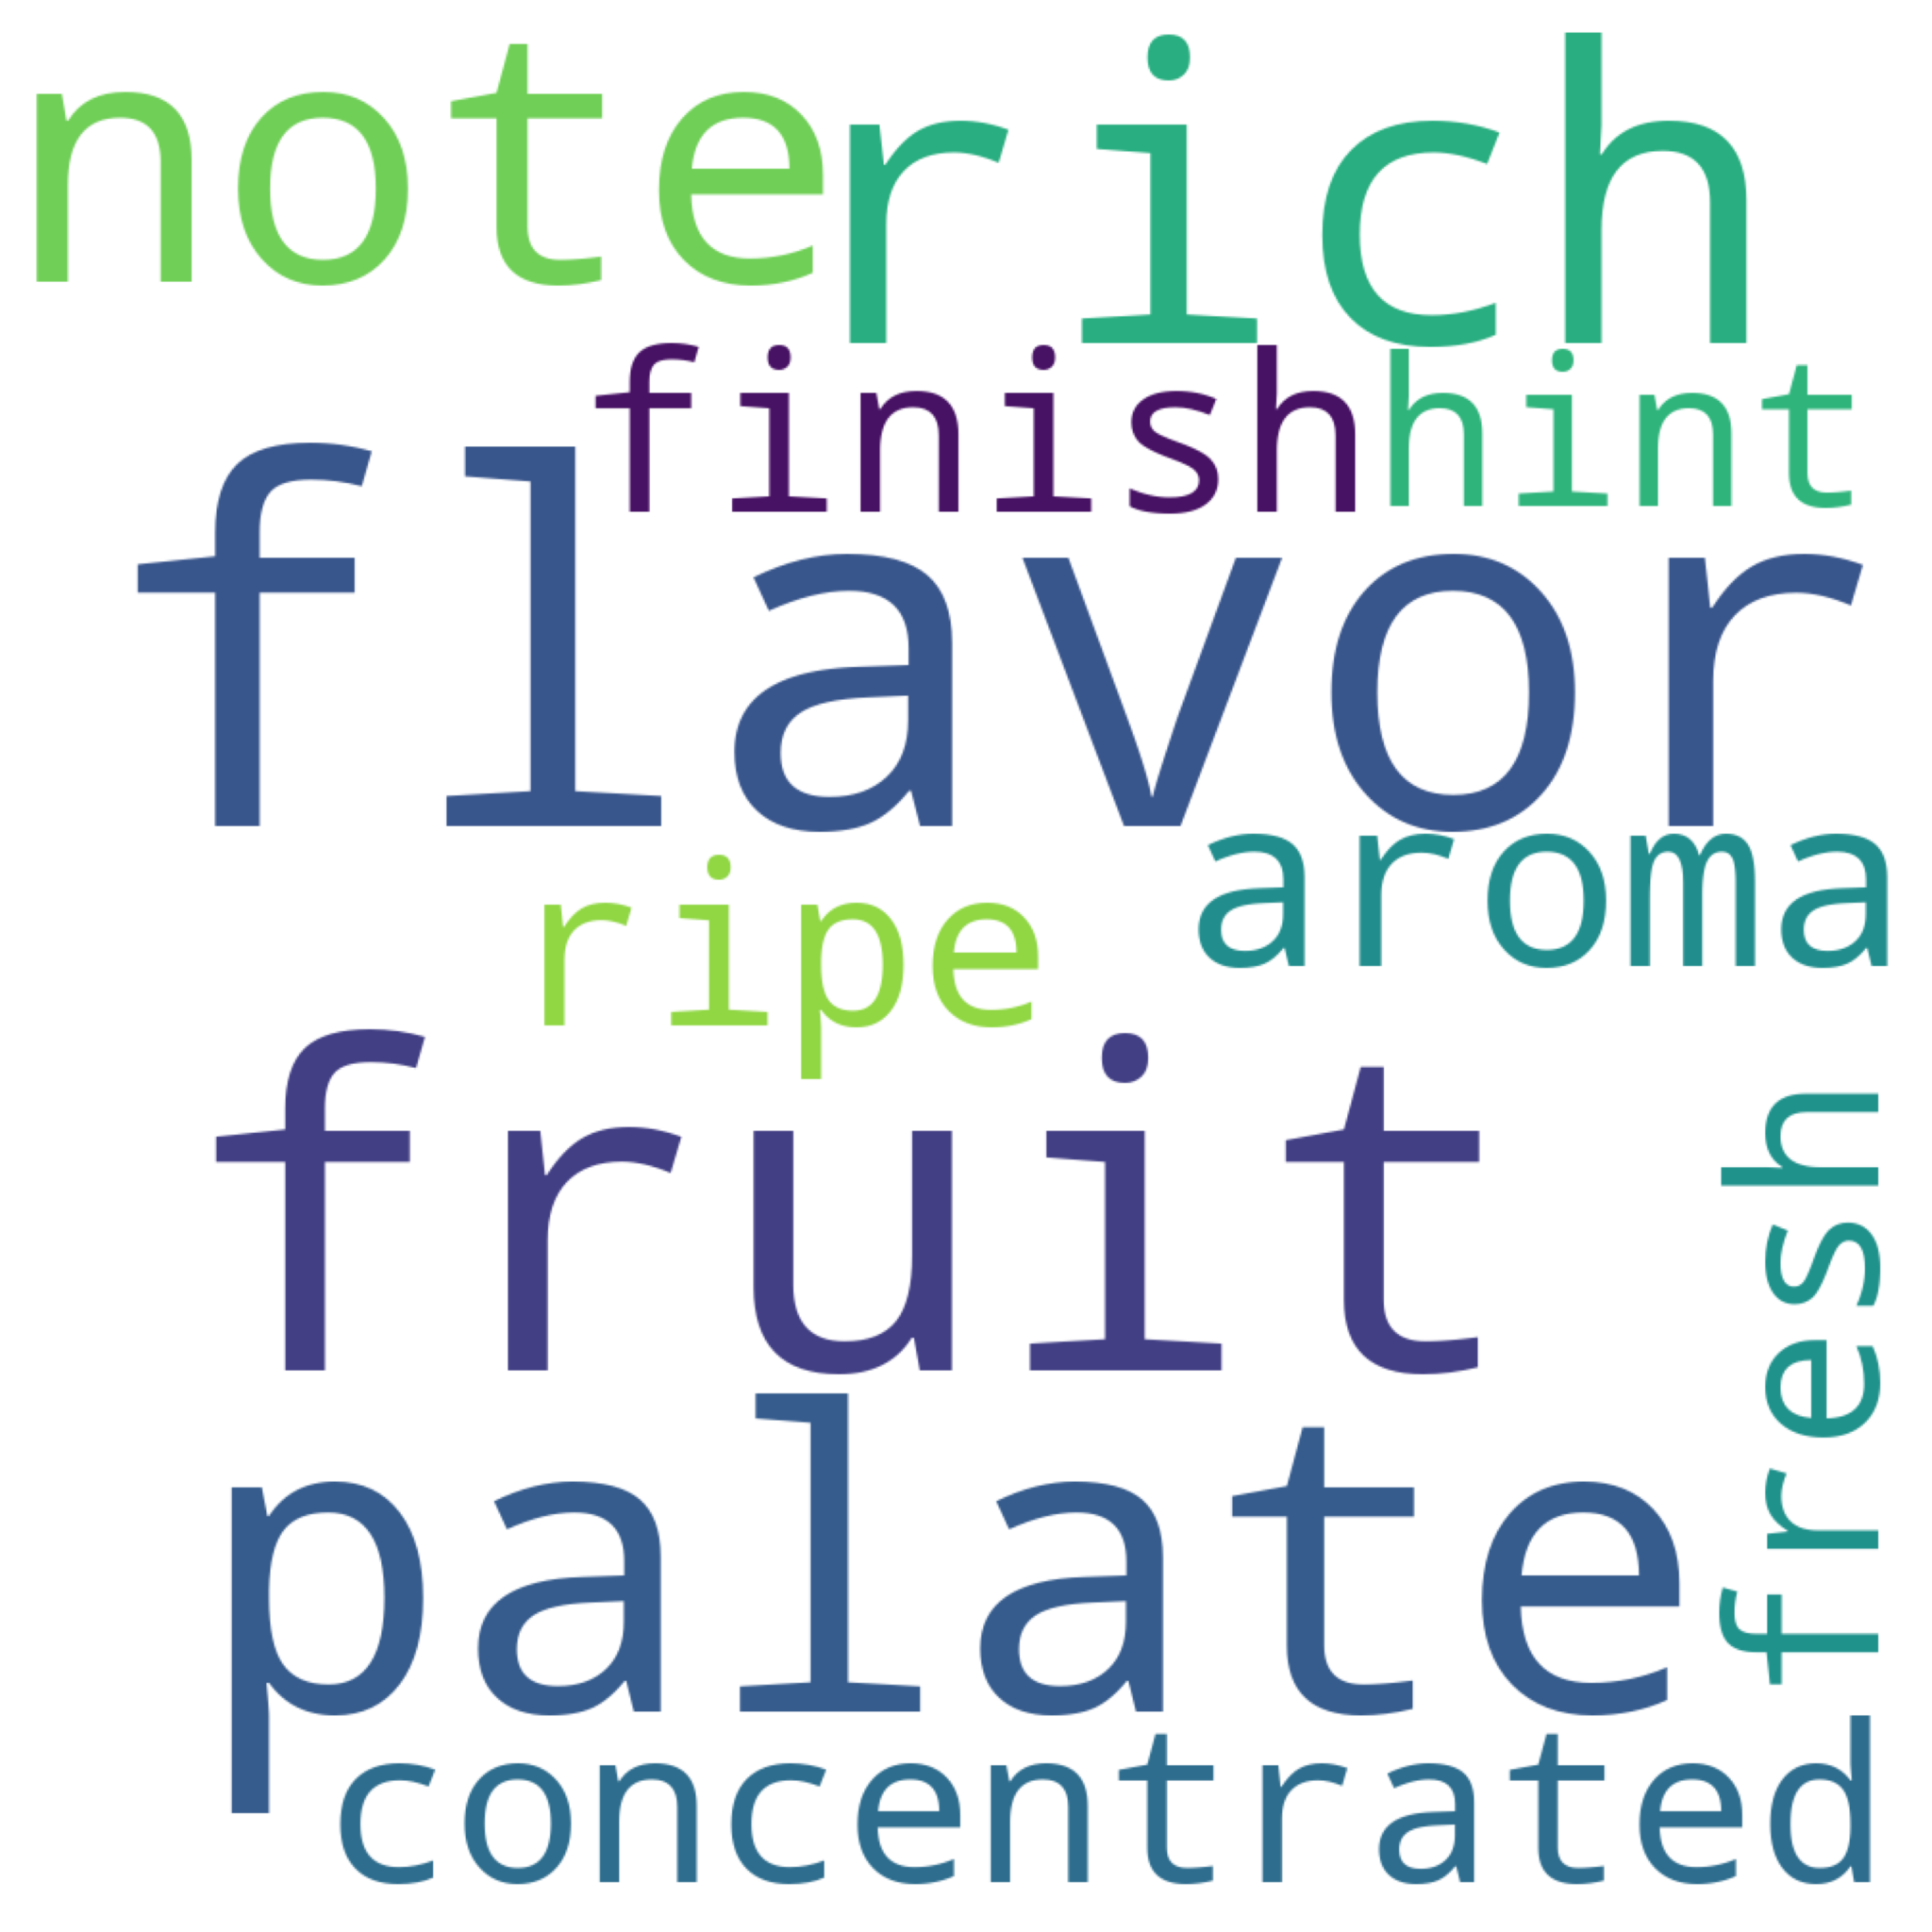
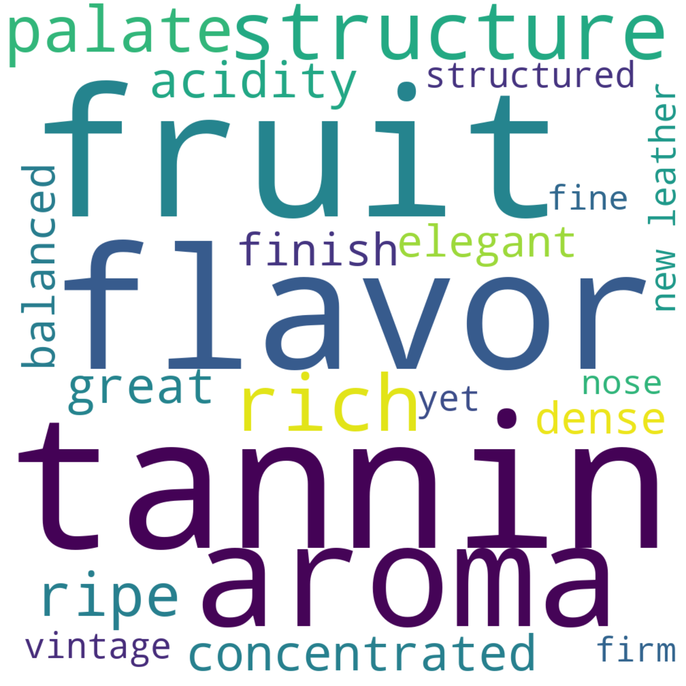
Most used words
Acceptable
Good
Very Good
Excellent
Superb
Classic

